Slide 1
Lecture 1 Introduction
Notes:
4G，速度，换卡，实名制，新闻

Slide 2
Modern Communication
Wireless
Mobile communication (1G,2G,3G,4G,5G)
Satellite communication
Visible light communication
……
Wired
Optical fiber communication
Cable TV
……

Slide 3
Mobile communication
1G (the first generation)
A network and B network
Simulation system
FDMA, different users at the same time allocate different frequency points

Slide 4
Mobile communication
2G (the sencond generation)
C network, G network and D network
Digital system
TDMA, different users allocate different slots at the same frequency
C network: CDMA1X
G network: GSM, “Gotone”

Slide 5
Mobile communication
2.5G
GPRS(General Packet Radio System)
115 kbps, supporting on-line at any time, charging by flow or time
EDGE (Enhanced Data rates for Global Evolution)
384 kbps, supporting wireless multimedia, e-mail, network entertainment, video conferencing, etc.
WAP(Wireless Application Protocol)
Access the Internet, but they require the website to be written in WML, which is equivalent to HTML on the Internet.

Slide 6
Mobile communication
3G (the third generation)
TD-SCDMA, WCDMA, CDMA2000, WiMAX
China issued three 3G licenses in January 2009
Simultaneous allocation of different codewords at the same frequency by different users
144 kb/s in high-speed mobile environment, 384 kb/s in walking slow mobile environment and 2Mb/s in stationary state.

Slide 7
Mobile communication
4G (the fourth generation)
TD-LTE and FDD-LTE
Different users allocate different subcarrier groups (OFDM)
Downlink speed of 100Mbps and up speed of 20Mbps
In December 2013, China issued TD-LTE licenses to three operators at the same time.

Slide 8
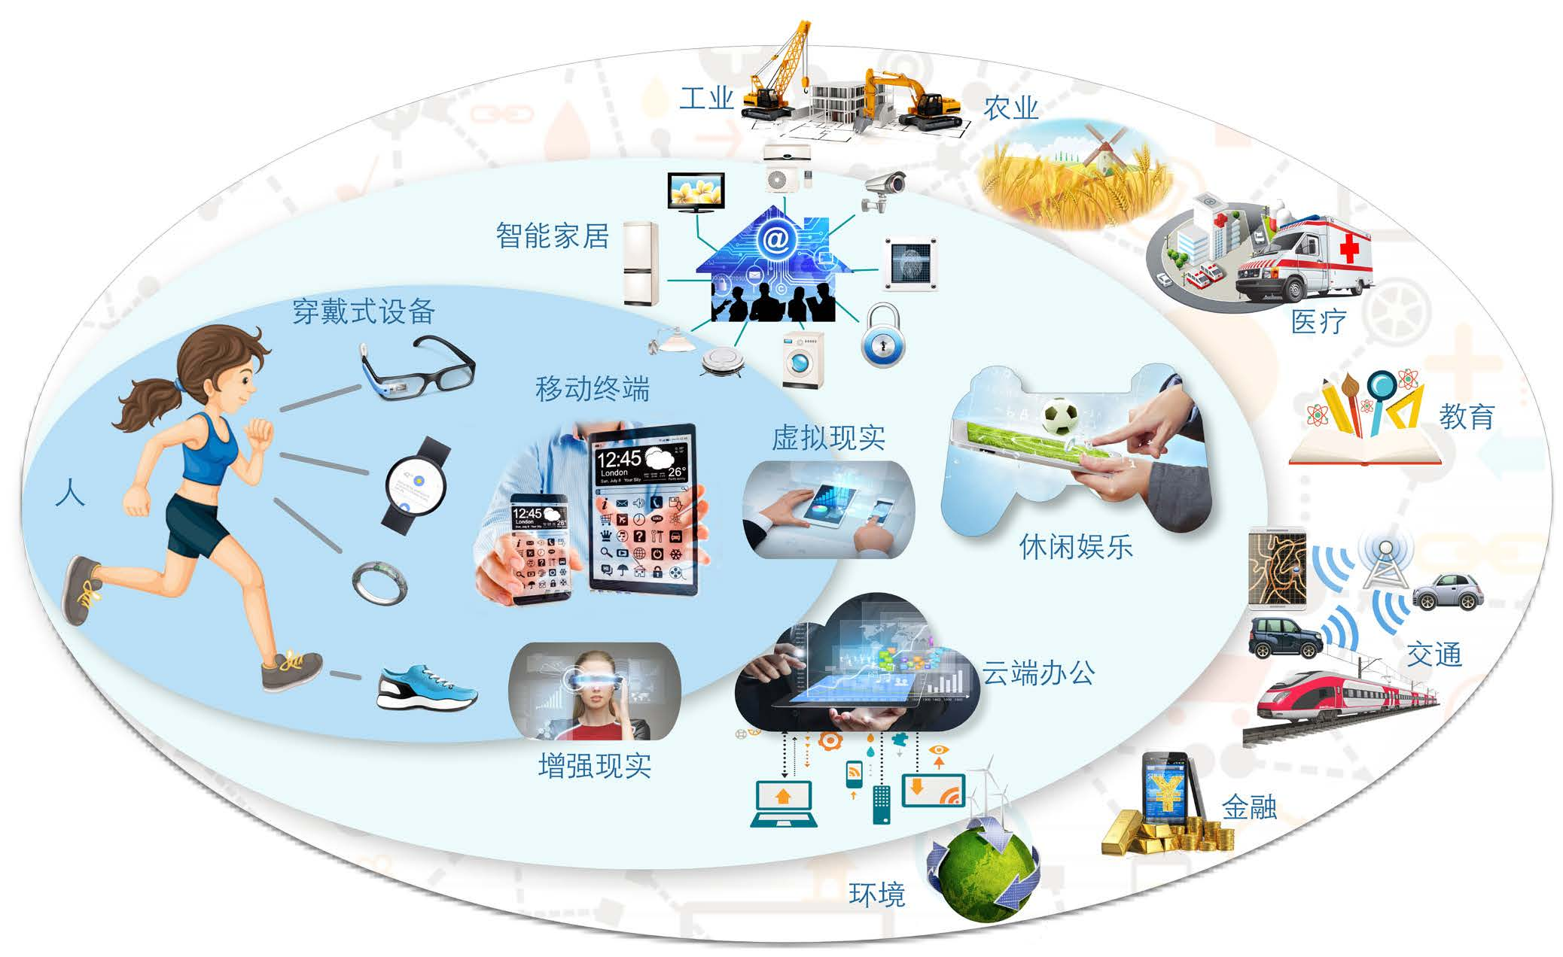
5G (Incoming)
5G Development Demand
Mobile Internet and Internet of Things are the two driving forces of future mobile communication development

Slide 9
5G Development Demand
Mobile communication will continue to develop rapidly
The number of users, connecting devices and data continue to grow exponentially.
VNI Global Mobile Data Traffic Forecast 2013-2018, Cisco, 2014
The Mobile Economy, GSMA, 2014
Internet of Things, Cisco, 2013
IMT-2020 Summit, Samsung, 2014
1EB=1000PB
1PB=1000TB
Notes:
目前，4G网络已经部署，4G技术已经趋于成熟。但是随着无线移动设备和移动业务的快速增加，4G依然无法完全满足未来持续增长的无线通信需求。面向未来通信发展的第五代移动通信系统的研发已经在世界范围内全面开展。大数据——Volume（大量）、Velocity（高速）、Variety（多样）、Value（价值）。

Slide 10
5G Development Demand
New mobile services emerge endlessly
Cloud operation, virtual reality, augmented reality, intelligent devices, intelligent transportation, telemedicine, remote control and other applications require more and more mobile communications.
Notes:
2015年8月12日晚11时许,天津滨海新区一处集装箱码头发生爆炸。无人机进行航拍。

Slide 11
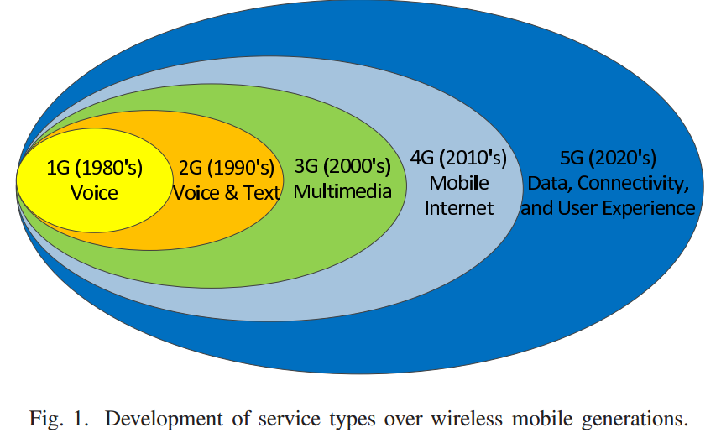
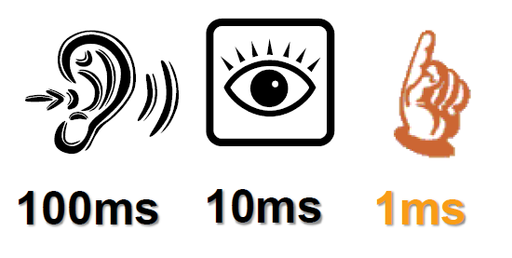
5G Development Demand
User Experience Requirements Increasing
Billions of Device Connections (Everywhere)
Massive Data Transfer (Big Data)
The Touch-and-Get User Experience (High QoE)
Notes:
据介绍，目前3G的时延是100毫秒，4G的时延20-30毫秒，未来5G则将是1毫秒的时延。这将使得汽车自动驾驶真正实现，上网做绝大部分事情都无需等待。
举例而言，根据统计欧盟每年有大约80万人出现心脏骤停现象，而幸存者比例仅为8%左右。造成如此低的存活率的主要原因在于应急部门需要大约10分钟的响应时间，而心脏骤停后大约4到6分钟便会导致脑死亡和最终的死亡。

Slide 12
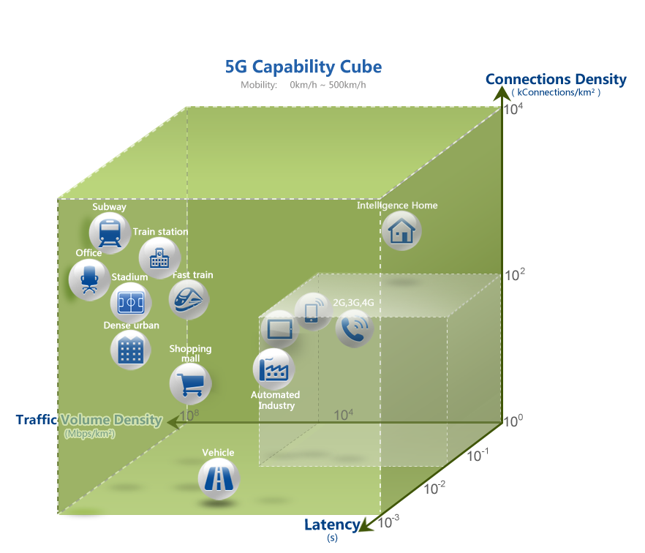
5G Development Demand
4G can not meet future business and user experience needs
Uniform User Experience at Anytime and Anywhere
High user-intensive areas
High-speed mobile scene
Very low latency requirements
……
TU-R WP5D/TEMP/390-E
Notes:
ITU-R WP5D/TEMP/390-E
未来用户对移动通信的求不仅局限在室内、和低速移动场景，而是追求任何时间、任何地点的一致用户体验。

Slide 13



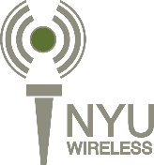






5G Development Demand
The research of 5G technology has been carried out all over the world.
5G IC
Notes:
中国（华为）、韩国（三星电子）、日本、欧盟都在投入相当的资源研发5G网络。华为开放日。

Slide 14

5G Development Demand
Key Technical Indicators Requirements of China IMT-2020 (5G) Propulsion Group
5G vs 4G
Size and scenario
10-fold increase in user density
100-fold increase in data traffic density
Double Moving Rate Increase
Data rate
1000-fold unit area capacity growth
Dozens of growth rate of user experience
Dozens of Peak Transmission Rate Growth
Time delay
Decade end-to-end latency reduction
Energy consumption and cost
100-fold increase in energy efficiency
10-fold increase in spectral efficiency
100-fold Cost Efficiency Increase

Slide 15
5G Development Demand
Comparison of 5G Key Performance Indicators with Existing Standards
Notes:
高清电影；网速？存储空间大小？电池？
HSPA High-Speed Packet Access
通用移动通信系统，简称UMTS(Universal Mobile Telecommunications System)，UMTS支持1920kbps的传输速率（不是经常看到的2Mbps），然而在现实高负载系统中典型的最高速率大约只有384Kbps。

Slide 16

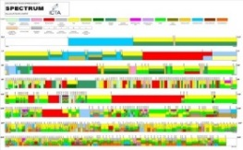


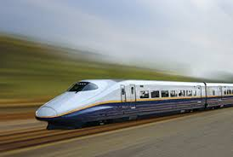


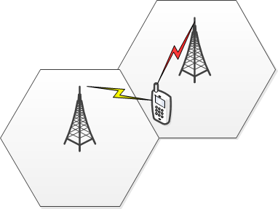
5G Development Demand
Limited spectrum resources restrict the performance improvement of wireless communication systems
Challenge
Spectrum resources
Seamless access
Power
Device
Channel
Interfere
The deterioration of channel in high-speed mobile environment and the development of high-frequency channel bring challenges to high transmission rate technology.
Multi-band, multi-access mode and small coverage radius bring challenges to network technology
New Communication Technology and High Frequency Band Development Bring Challenges to Semiconductor Technology
Increased energy consumption brought by mass equipment challenges the requirements of green communication
Interference caused by cell-intensive and the increase of mobile devices restricts the growth of network capacity and transmission rate
Notes:
5G关键技术主要面临的挑战主要有：频谱资源有限、信道条件在高速移动中恶化以及新频段信道特性的表征、

Slide 17



5G Development Demand
What key technologies are needed to achieve the 5G development goals?
The improvement of 5G communication performance does not depend solely on one technology, but on the cooperation of various technologies.
5G
4G
？
3G
2G
OFDM、MIMO
LTE-A
WiMAX
SAE
CDMA
TD-SCDMA
WCDMA
CDMA-2000
GPRS Core Network
TDMA
GSM
NSS
Notes:
NSS： Network Switching Subsystem 网络交换子系统
GPRS: General Packet Radio Services 通用分组无线业务技术
SAE： system architecture evolution 演进的系统体系结构

Slide 18
Key Transport Technologies - Overview
Increase coverage
Increase channel
Increase bandwidth
Increase SINR
Coverage Enhancement Technology
Frequency Effect Lifting Technology
Spectrum Expansion Technology
Energy Efficiency Improvement Technology
Ultra-dense Heterogeneous Networking
D2D, M2M
Massive MIMO, FBMC, space modulation
Cognitive Radio,
Millimeter Wave and Visible Light
Green communication,
Interference management
Multiple Access Technology, User Scheduling, Resource Allocation, User/Network Collaboration
Notes:
信息论，高斯信道，香农公式，
FBMC——Filter Bank Multicarrier

Slide 19
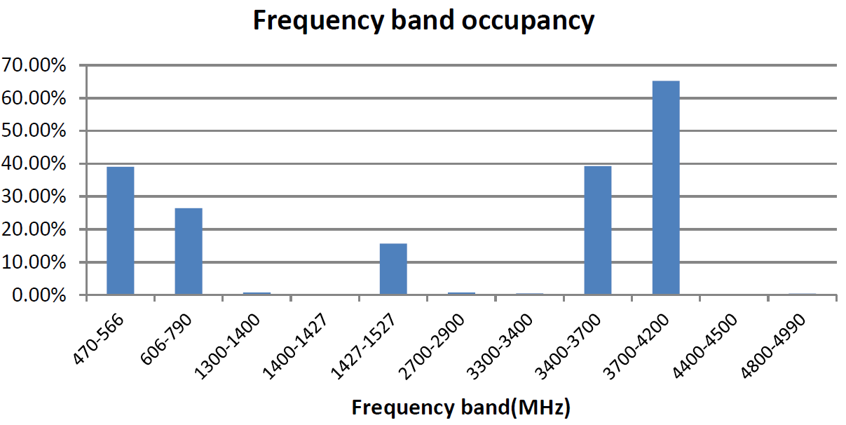
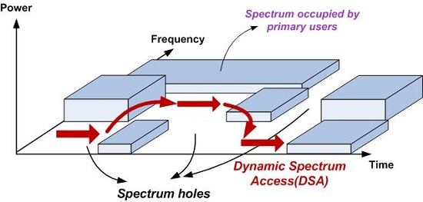
Key Transmission Technology (1) - Cognitive Radio
Cognitive Radio: Improving the Utilization Efficiency of Distributed Spectrum
In July 2014, the National Radio Monitoring Center and the Global Association of Mobile Communications Systems released the "450MHz-5GHz Concerned Band Spectrum Resources Assessment Report", giving statistics of radio spectrum occupancy in Beijing, Chengdu and Shenzhen.
Statistical results show that most of the frequency bands under 5 GHz are far less than 10%, which indicates that there is a lot of room for improvement in the efficiency of the frequency bands below 5 GHz.
In order to improve spectrum efficiency, cognitive radio technology is needed in the future 5G.
Notes:
http://www.brunel.ac.uk/cedps/electronic-computer-engineering/research-activities/wncc/student-profiles/abdullah-masrub
J. Xue, Z. Feng, and P. Zhang, "Spectrum Occupancy Measurements and Analysis in Beijing," IERI Procedia, vol. 4, pp. 295-302, // 2013.

Slide 20
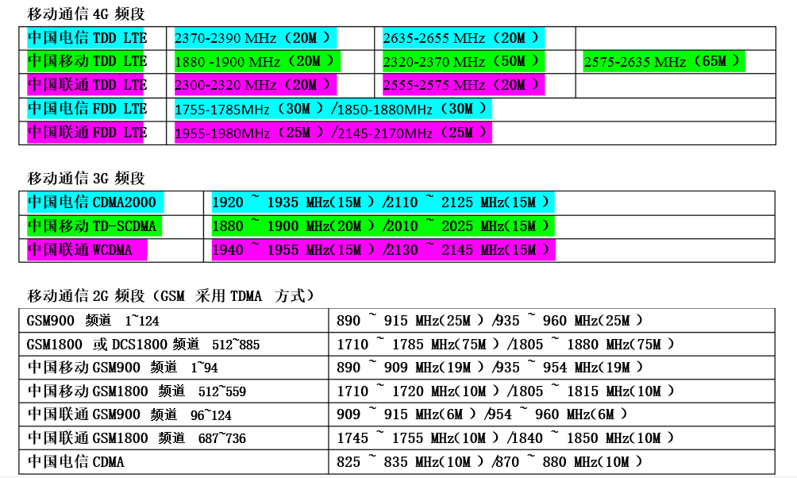
Mainland Mobile Communication Band (2G, 3G, 4G)

Slide 21
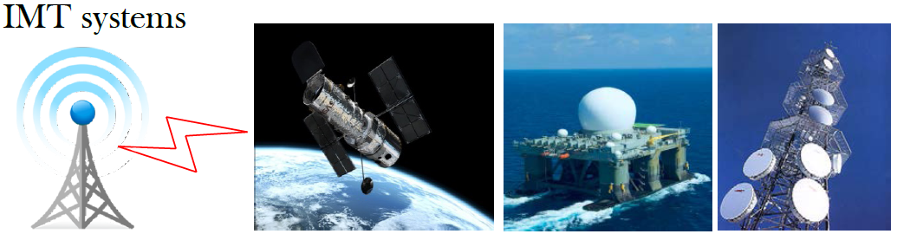
Key Transmission Technology (2) - Spectrum Expansion Technology
Increasing bandwidth is the most direct way to increase capacity and transmission rate
Spectrum resources below 6GHz are scarce
Above 6GHz spectrum resources are abundant
WRC-15 AI 1.2 candidate bands below 6GHz
2G/3G/4G re-farming
Potential bands above 6GHz for 2020’s
0
3GHz
6GHz
>60GHz
Global interest bands for WRC-15
<1 GHz [MHz] | 410-430, 470-694/698, 694/698-790
1-2 GHz [MHz] | 1300-1400, 1427-1525/1527, 1695-1700/1710
2-3 GHz [MHz] | 2025-2100, 2200-2290, 2700-3100
3-5 GHz [MHz] | 3300-3400, 3400-4200, 4400-5000
5-6 GHz [MHz] | 5150-5925, 5850-6245
(>6GHz) Spectrum Allocation Principle
Priority to guarantee the spectrum resources of mobile communications
Technologically achievable
Continuous 500MHz Bandwidth Availability
Coexistence with other systems
WRC-15 AI 1.2
Notes:
世界无线电通信大会（World Radio Communication Conference）
目前，国内指配给IMT(International Mobile Telecommunication，国际移动通信)服务的无线频谱总宽度为687MHz。据工信部预测，到2020年，中国IMT的频谱缺口为1.177GHz左右。
6GHz以下的频谱无法填补如此大的带宽缺口。

Slide 22
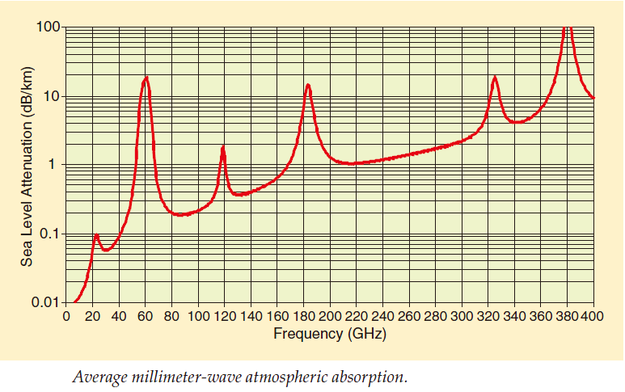
Key Transmission Technology (2) - Spectrum Expansion Technology
Millimeter Wave Communication: Developing High Frequency Band
High-frequency bandwidth resources are yet to be developed → 60GHz band
mmWave, 30~300 GHz, 1~10 mm, Generalized mmWave Includes 20~30 GHz
Advantage
Available bandwidth, providing tens of GHz bandwidth
Good orientation and little interference
Challenge
Beam Concentration to Improve Energy Efficiency
High hardware implementation complexity (e.g. high-speed A/D and D/A design challenges)
Diffraction ability is poor and NLOS is limited.
Influenced by air and rain, etc.
Path loss is too high to be suitable for long-distance communication
军事
卫星
10~400 GHz frequency band atmospheric attenuation
MmWave can be used for indoor short-distance communication and backhaul link for 5G mobile communication system.
Notes:
30GHz以下的“好”频谱已经分配殆尽。 30GHz以上可用带宽丰富。
毫米波在35\90\110\220\340GHz处有几个大气窗口，具有相对低的空气吸收衰减。有些大气窗口已经被占用。
毫米波在60GHz受到氧气吸收，存在较大的大气衰减，其他峰值衰减是水蒸汽等大气分子吸收造成。
Backhaul链路，例如移动飞蜂网为高速移动的列车提供回程链路。
回程链路（backhaul）是指从接入网络或者小区站点（cellsite）到交换中心的连接。回程链路网络是任何电信网络结构的中间层，它位于接入网络和骨干网络之间，为这两个网络提供了重要连接

Slide 23
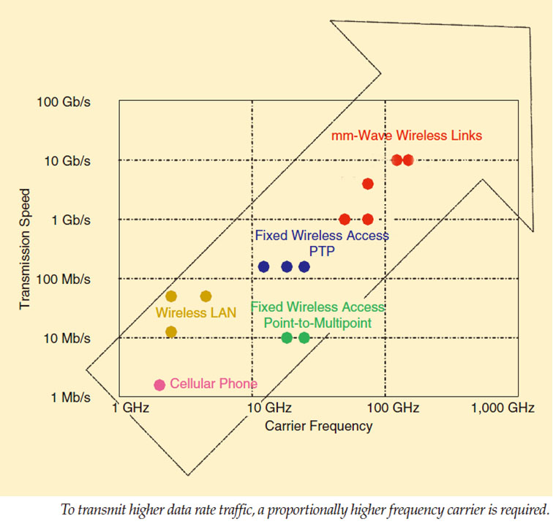
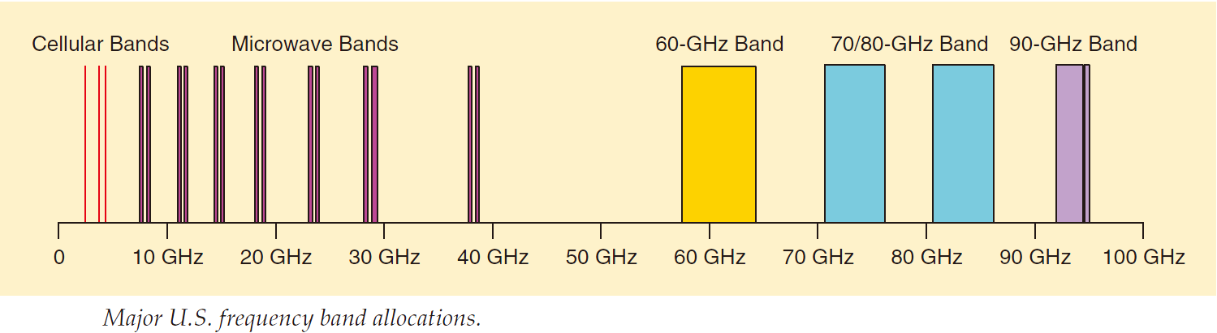
Key Transmission Technology (2) - Spectrum Expansion Technology
Millimeter Wave Communication: Developing High Frequency Band
Commercial bandwidth allocation, narrower below 40GHz
Commercial bandwidth allocated over 40 GHz is tens of GHz
Millimeter-wave communication technology has achieved 10 Gbps transmission rate
It is predicted that the millimeter wave communication rate will be faster than the optical fiber rate in the future.
To achieve higher transmission rate, higher carrier spectrum is needed.
The frequency band below 10GHz can only reach tens of Mbps.
10-40 GHz band, only a few hundred Mbps
60-80 GHz band, up to 1 Gbps
More than 100 GHz, up to 10 Gbps
Notes:
J. Wells, "Faster than fiber: The future of multi-G/s wireless," Microwave Magazine, IEEE, vol. 10, pp. 104-112, 2009.
60GHz、740GHz、80GHz频段带宽各为5GHz
94GHz频段带宽为3GHz

Slide 24
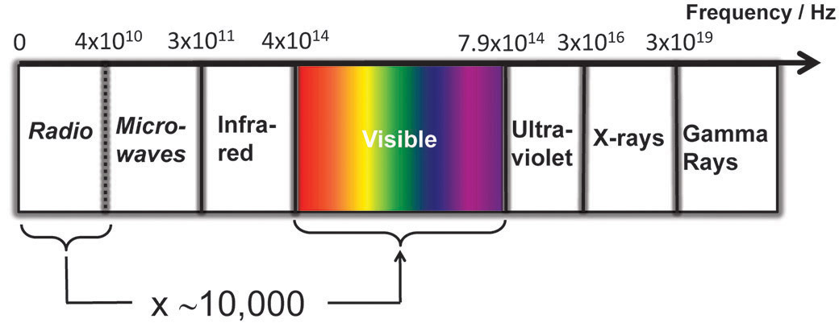
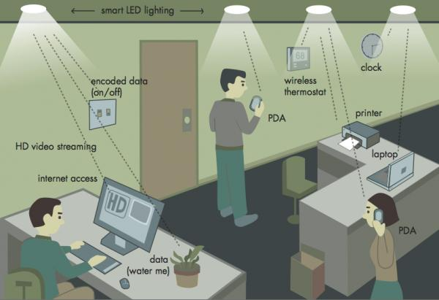
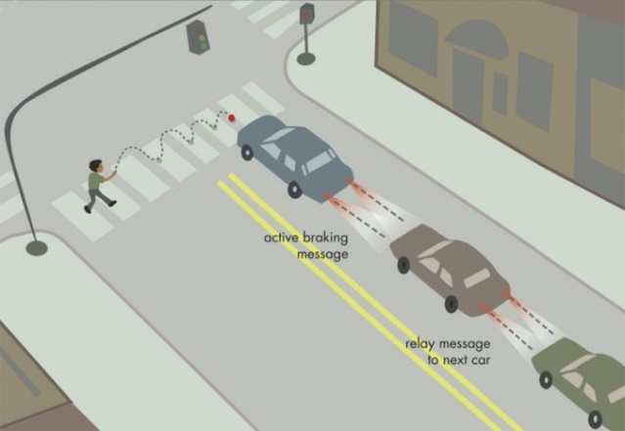
Key Transmission Technology (2) - Spectrum Expansion Technology
Visual light communication: VLC
780nm
380 nm
Visible spectrum bandwidth is ten thousand times that of radio spectrum bandwidth
Advantage
Challenge
At present, only one-way communication can be realized. How to realize two-way communication
The signal source is LED with low cost and low power consumption.
High-speed transmission (3.5Gbps per LED)
Difficult to penetrate obstacles, less interference
Communications can be provided while illuminating
Seamless switching between visible light communication and radio frequency communication
Visible light communication can be used for indoor short distance communication, vehicle network communication, underwater communication and so on in 5G.
Notes:
可见光通信：室内通信、车车通信、水下通信等。
单个LED可传输多大的速率？ 光纤通信目前波长在1200nm至1600nm区间，该区间光纤传到损耗小。可见光在光纤中传导的损耗大，不适合在光纤中应用。
2015-02-16外媒消息，牛津大学的研究人员利用波分复用技术成功完成了无需借助光纤的100Gbps可见光通信试验。

Slide 25
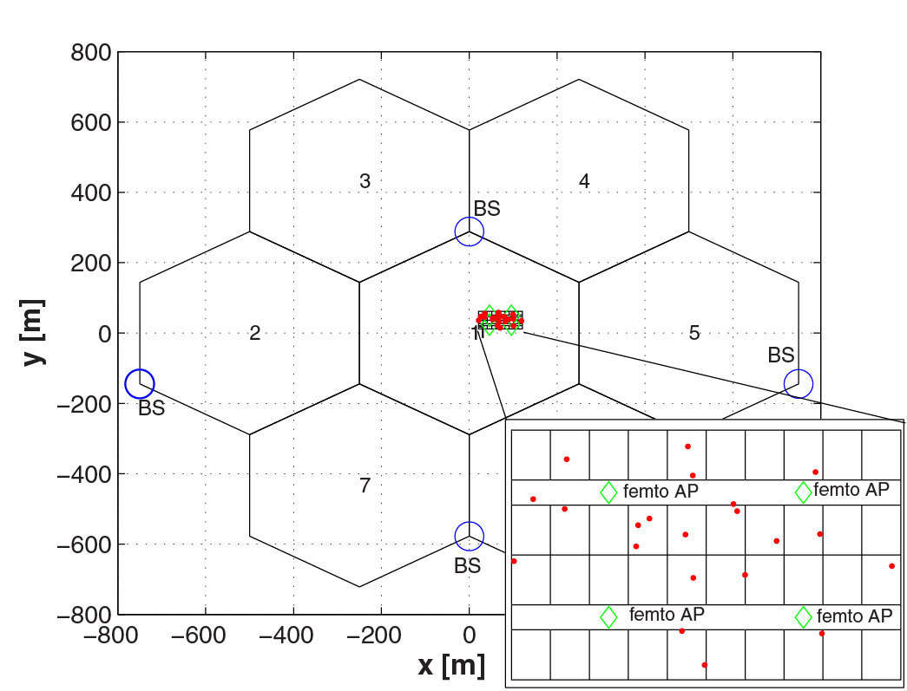
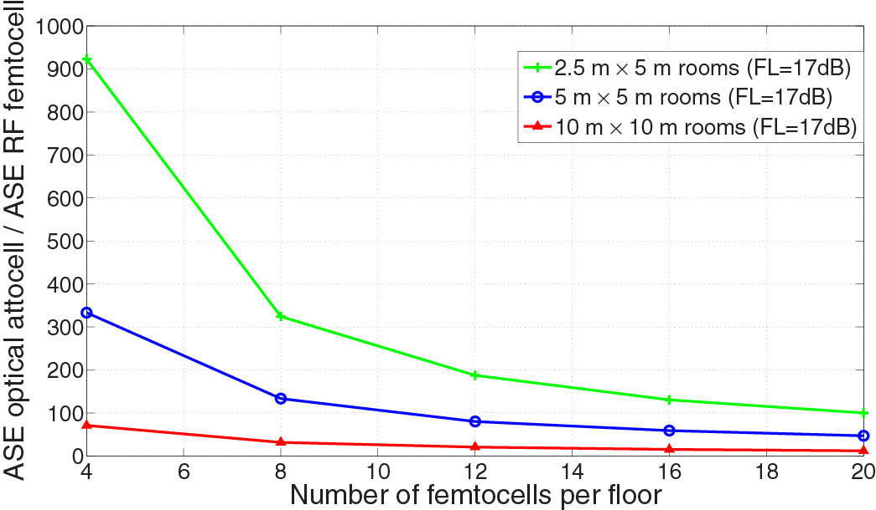
Key Transmission Technology (2) - Spectrum Expansion Technology
Visual light communication: VLC
Previous studies have shown that the spectral efficiency of optical attocell is nearly three orders of magnitude higher than that of radio frequency Femtocell.
Visible light communication can significantly improve the transmission rate of indoor communication
Red dots denote Attocell's visible light base station and green diamonds denote Femtocell's radio frequency base station.
ASE :单位面积频谱效率比值
Femtocell: 飞蜂窝
Attocell: 豪飞小区
H. Haas, "High-speed wireless networking using visible light," SPIE Newsroom, 2013.
Notes:
飞蜂窝(英文为Femtocell)是近年来根据3G发展和移动宽带化趋势推出的超小型化移动基站。Attocell——豪飞小区。

Slide 26
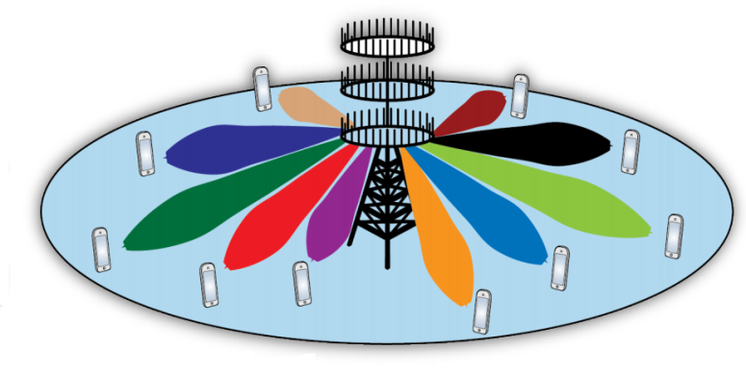
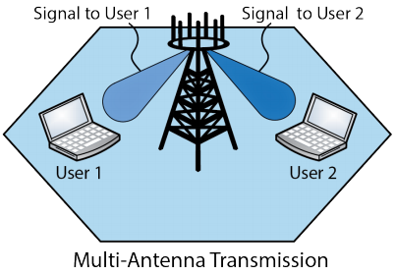
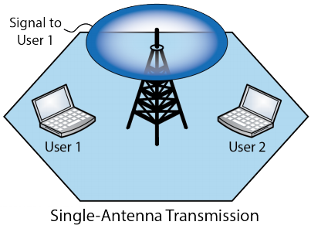
Key transmission technology (3) – Massive MIMO technology
Evolution of MIMO Technology
5G
Massive MIMO : base stations use large-scale antenna arrays (dozens or even hundreds of antennas)
4G：3GPP LTE
Support SISO, 2 x 2 MIMO, 4 x 4 MIMO. Downlink Peak Rate 100Mb/s
4G：3GPP LTE-A
3G：WCDMA HSPA
Up to 8 x 8 MIMO with downlink peak rate of 1 Gb/s
SISO only, downlink peak rate 7.2Mb/s
3G：WCDMA HSPA+
Supporting 2 x 2 MIMO, downlink peak rate 42Mb/s
Notes:
自己手机的天线数？蓝牙、WiFi、蜂窝网

Slide 27
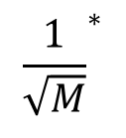
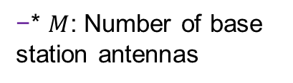
Key transmission technology (3) – Massive MIMO technology
Massive MIMO: Effective improvement of spectral efficiency
What is a large antenna: a large number of antennas provide simultaneous transmission services for relatively few users
Advantage
System capacity and energy efficiency have been greatly improved
Challenge
Channel State Information Acquisition (Pilot Pollution Problem)
Both upstream and downstream emission energy will be reduced
Orthogonal channel between users, interference and noise will be eliminated
Statistical characteristics of channels tend to be stable
Channel Measurement and Modeling (Channels in Different Scenes)
Transmitter and Receiver Design (Reducing Complexity)
Antenna element and array design (low energy antenna)
10 times
100 times
Transmission energy
system capacity
energy efficiency
$${\frac{1}{\sqrt{M}}}^{∗}$$
* $M$: Number of base station antennas
Massive MIMO is recognized as one of the key technologies of 5G
Notes:
M=100? IEEE JSASP——IEEE JOURNAL OF SELECTED TOPICS IN SIGNAL PROCESSING

Slide 28
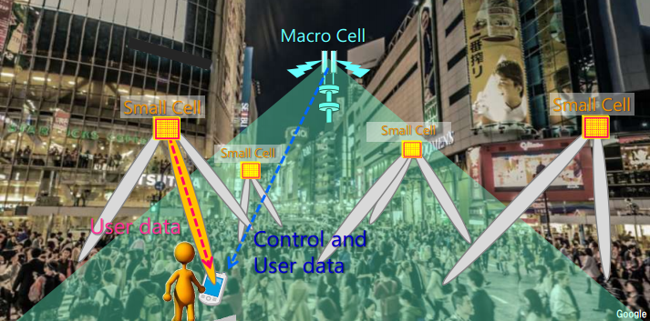
Key transmission technology (3) – Massive MIMO technology
Massive MIMO application scenario: central antenna system
It is suitable for macro cellular cell. Large antenna is used in central base station.
Microcells provide services for most users, while large-scale antenna base stations provide services for users outside the microcell range, while controlling and scheduling the microcells.
Notes:
宏小区基站使用大规模天线，大部分用户由微小区提供服务，微小区无法服务的用户由中心基站直接服务，同时，中心基站对微小区进行控制和调度

Slide 29
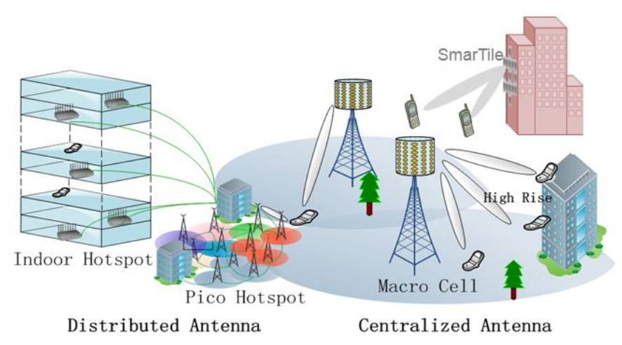
Key transmission technology (3) – Massive MIMO technology
Massive MIMO application scenario: distributed antenna system
Multi-antennas distributed in the region for joint processing (C-RAN)
Suitable for high user density or indoor scenes
Notes:
pico hotspot——微热点；SmarTile——紧凑型射频天线模块； High Rise 高楼大厦
C-RAN是基于集中化处理(Centralized Processing)，协作式无线电(Collaborative Radio)和实时云计算构架(Real-time Cloud Infrastructure)的绿色无线接入网构架(Clean system)。（C-RAN）

Slide 30


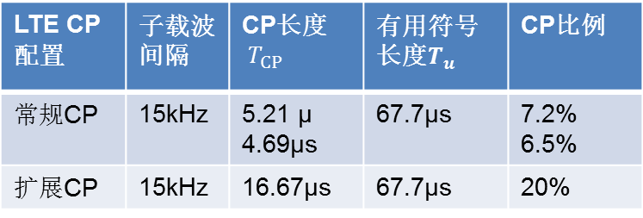
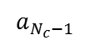

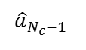
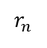
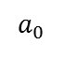
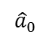
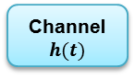
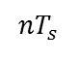

Key transmission technology (4) - new transmission waveform Technology
OFDM transmission waveform Technology
OFDM is the main mode of high-speed wireless communication in current Wi-Fi and LTE standards.
Transmitter
Noise
优势
High spectrum efficiency (double as compared with traditional FDM)
挑战
Inter-symbol Crosstalk and Inter-user Interference Caused by Carrier Frequency Offset
Anti-frequency selective fading
Using FFT/IFFT module, it is easy to realize.
Cyclic prefix (CP) reduces frequency efficiency and energy efficiency
Realization of Millimeter Wave Band (e.g. Ultra Wide Band, High Frequency Power Amplifier, etc.)
$$a_{0}$$
OFDM
mod.
(IFFT)
$$⋮$$
$$⋮$$
CP
insertion
Channel
$$h(t)$$
$$a_{N_{c}−1 }$$
Receiver
$${nT}_{s}$$
$${\hat{a}}_{0}$$
OFDM
demod.
(FFT)
$$r_{n}$$
$$⋮$$
$$⋮$$
CP
removal
$${\hat{a}}_{N_{c}−1 }$$
LTE CP配置 | 子载波间隔 | CP长度${ T}_{CP}$ | 有用符号长度$T_{u}$ | CP比例
常规CP | 15kHz | 5.21 μ 4.69μs | 67.7μs | 7.2% 6.5%
扩展CP | 15kHz | 16.67μs | 67.7μs | 20%
OFDM is the key transmission waveform technology of 5G in the future, and its performance still has room for improvement.
Notes:
（信道的时间色散会破坏子载波的正交性，从而造成符号间干扰和载波间干扰。传统OFDM利用循环前缀减小符号间干扰和载波间干扰，但是降低了频谱效率能量效率）

Slide 31
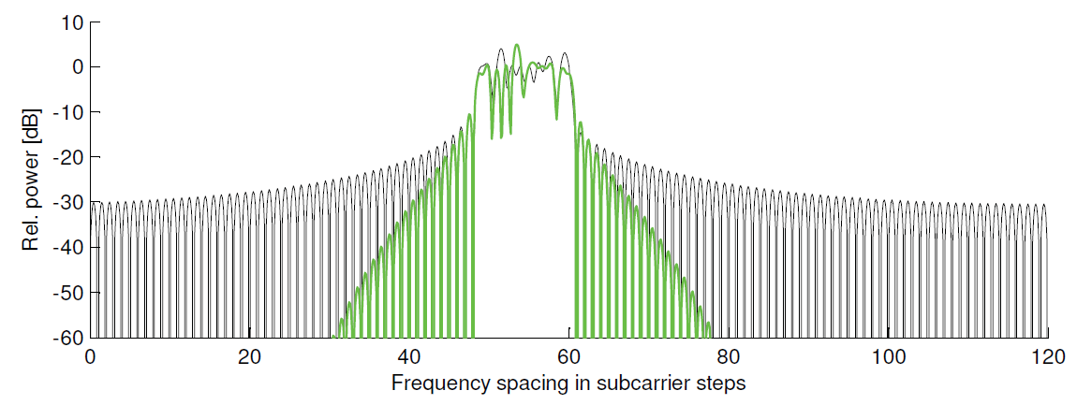
Key transmission technology (4) - new transmission waveform Technology
Filter bank multicarrier：FBMC
Transmitter
Noise
Power Spectrum of Traditional OFDM
FBMC Power Spectrum
$$a_{0}$$
OFDM
mod.
(IFFT)
$$⋮$$
$$⋮$$
Tx Filter Bank
Channel
$$h(t)$$
$$a_{N_{c}−1 }$$
Receiver
$${nT}_{s}$$
$${\hat{a}}_{0}$$
OFDM
demod.
(FFT)
$$r_{n}$$
$$⋮$$
$$⋮$$
Rx Filter Bank
$${\hat{a}}_{N_{c}−1 }$$
In addition to FBMC, there are many waveform improvement technologies, such as sparse code multiple access, generalized frequency division multiplexing.
Various improved transmission waveform technologies provide a variety of options for 5G performance improvement
Replacing CP with filter banks
Insensitive to carrier frequency offset
Increased frequency efficiency and energy efficiency
Notes:
数字信号调制，已调信号的功率谱越窄越好。

Slide 32
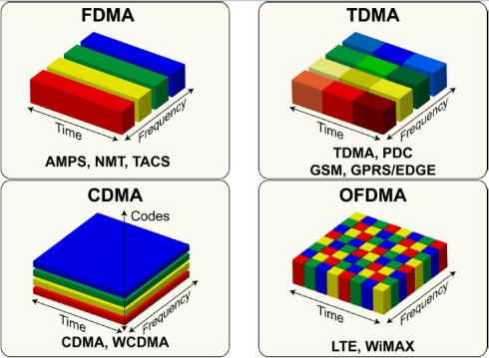
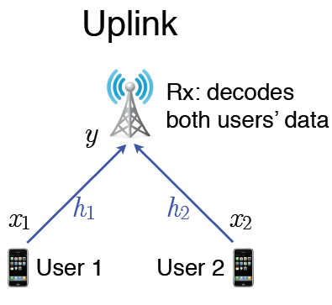
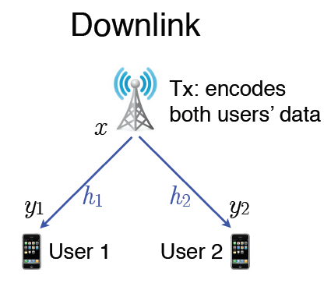
Key Transport Technology (5) - Non-Orthogonal Multiple Access Technology
Orthogonal Multiple Access Technology
Orthogonal access technology is used in existing communication standards.
Avoidance of Interuser Interference
According to information theory, the achievable capacity of orthogonal multiple access system is suboptimal
Advantage
Challenge
Easy to implement the system
1G
2G
3G
4G

Slide 33
Key Transport Technology (5) - Non-Orthogonal Multiple Access Technology
Orthogonal Multiple Access Technology
Optimal capacity region
1G
2G
Orthogonal scheme achievable rate region
3G
4G
SNR1=20dB（ Strong user ）, SNR2=0dB（ Weak user ）
Orthogonal access schemes are generally suboptimal, reaching and maximizing capacity only at point C, but at this point, user 2 (weak user) obtains a very small rate, so it is unfair for weak users.
Orthogonal multiple access can not guarantee optimal capacity and user fairness

Slide 34
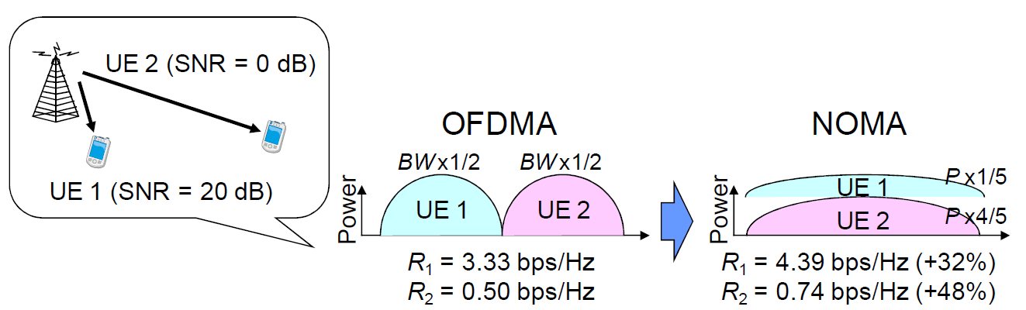
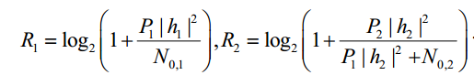
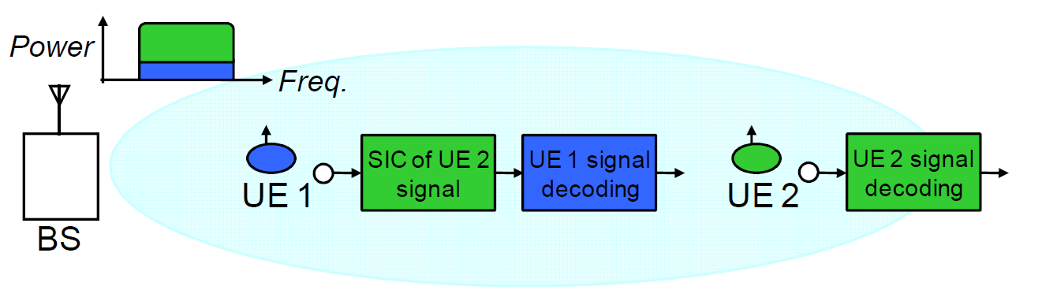
Key Transport Technology (5) - Non-Orthogonal Multiple Access Technology
Non-orthogonal Multiple Access: NOMA
NOMA
Two users occupy all available bandwidth at the same time
Strong users decode weak interference first, eliminate the influence of interference, and then decode their own messages.
Optimal capacity can be achieved, and the achievable rate of weak users can be improved.
Complexity
Capacity

Slide 35

Key Transmission Technologies (6) - Advanced Coding and Modulation Technologies
Evolution of Coded Modulation Technology
SM？
QPSK,16QAM,
64QAM
Digital modulation
5G
QPSK,16QAM
4G
3G
LDPC
Polar
Analog modulation
2G
Turbo
1G
Conv
BCH
Notes:
4G中，上行与下行链路均支持QPSK,16QAM和64QAM三种调制方式。
5G方向：通过新型星座图与调制方式设计，获得比现有调制方式更大的容量增益；通过设计改进的Turbo码、LDPC码等新型编码，获得更大的编码增益；设计新的支持更多参数自适应处理和优化的系统结构，提高系统性能。

Slide 36
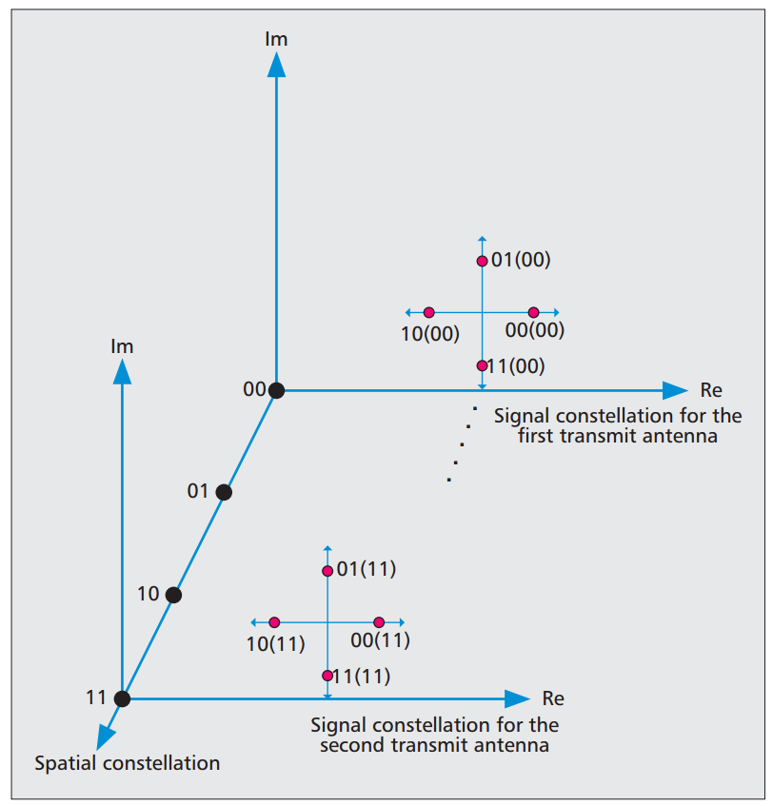

Key Transmission Technologies (6) - Advanced Coding and Modulation Technologies
Spatial Modulation: SM
The physical position of the antenna is used to carry part of the transmitted information bits, and the traditional two-dimensional mapping is extended to three-dimensional mapping to improve the spectral efficiency.
Only one transmitting antenna is in working state in each slot, which avoids the problem of inter-channel interference and synchronous antenna transmission, and the system only needs one radio frequency link, which effectively reduces the cost.
QPSK SM Constellation of 4-transmit Antenna
0
s1
Antenna Estimation
Data Bits
s2
s1
Channel
Data Bits
s1
Symbol Detection
0/1
1
SM system

Slide 37
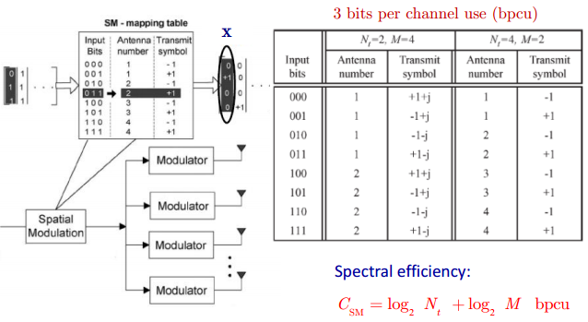
Key Transmission Technologies (6) - Advanced Coding and Modulation Technologies
Spatial Modulation: SM

Slide 38
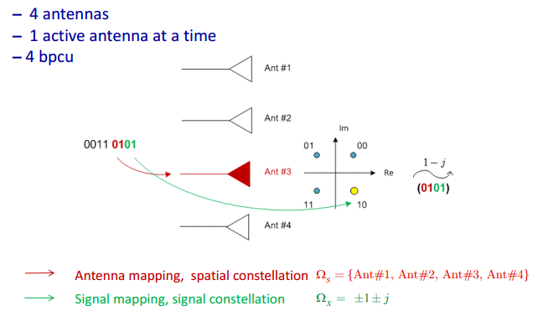
Key Transmission Technologies (6) - Advanced Coding and Modulation Technologies
Spatial Modulation: SM

Slide 39
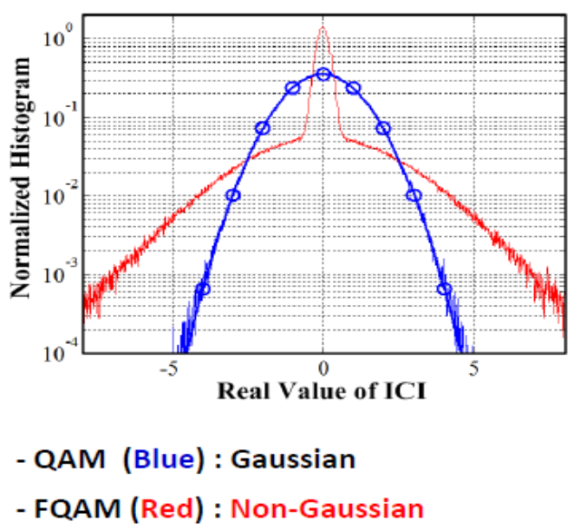
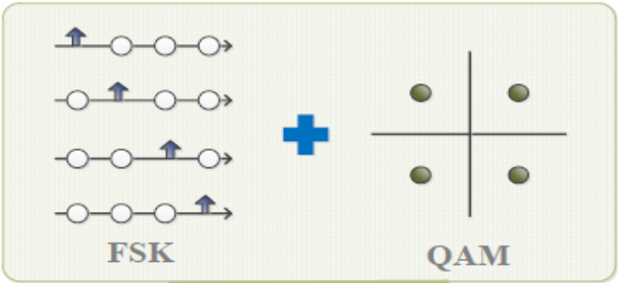
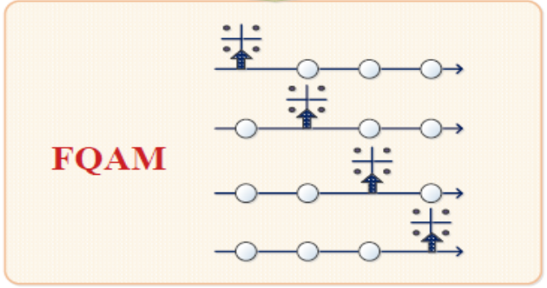

Key Transmission Technologies (6) - Advanced Coding and Modulation Technologies
Frequency Quadrature-amplitude Modulation: FQAM
According to information theory, non-Gaussian interference can achieve higher transmission rate.
The frequency shift keying (FSK) and quadrature amplitude modulation (QAM) are combined to improve the spectral efficiency.
It can improve the communication quality of edge users in multi-cell downlink.
ICI:码间干扰
Notes:
根据信息论，非高斯干扰可实现更高传输速率。研究已证明，在多小区通信中，采用FQAM能够改变小区边缘用户所受到的干扰分布，实现非高斯干扰，从而提高小区边缘用户的通信质量。

Slide 40
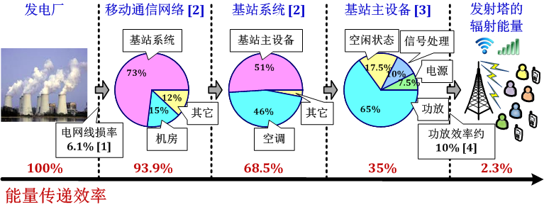
Key Transmission Technology (7) - Energy Efficiency Improvement Technology
2009年，三大运营商的能耗总量折合为440.7万吨标准煤，其中80%以上是电力消耗，达到290亿度，相当于2个大亚湾核电站的年发电量。

Slide 41
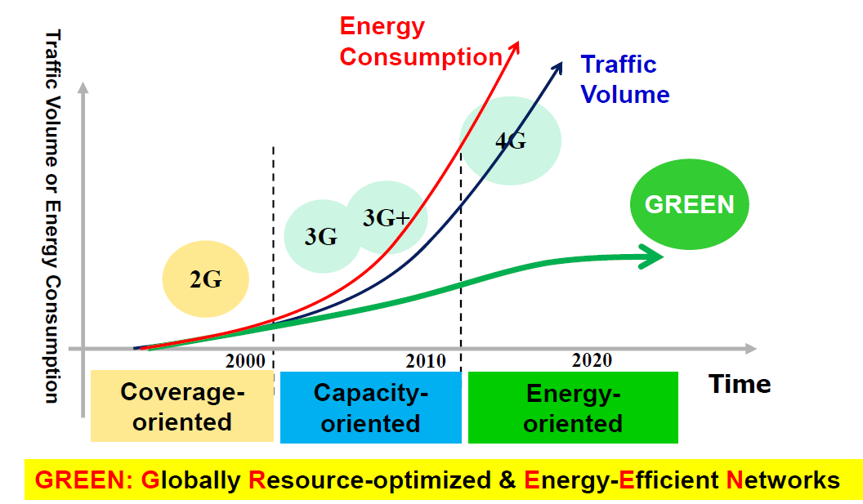
Key Transmission Technology (7) - Energy Efficiency Improvement Technology
How to approach GREEN while carrying 1000X traffic?

Slide 42

Key Transmission Technology (7) - Energy Efficiency Improvement Technology
多域协同无线资源管理 (Multi-domain Cooperative Radio Resource Management)
业务域
(business)
应用层
(application layer)
语音
（VOIP）
非实时数据
（FTP）
实时数据
（WEB）
多媒体
（MMS）
组播/广播
（VOIP）
用户域
(user)
网络层
(network layer)
码域
（CDMA）
能量域
（POWER）
物理层
(physical layer)
资源域
(resources)
时域
（TDMA）
频域
（OFDM）
空域
（MIMO）
Notes:
多网各自为政。AN——Access Networks.

Slide 43



Key Transmission Technology (7) - Energy Efficiency Improvement Technology
Adaptive Matching of Network Resources with Dynamic User Behavior and Business Requirements
Tango: Traffic-aware network planning & green operation
- Adaptive to Service Distribution (Non-uniform Distribution in Time and Space)
- Adaptive to Service Characteristics (Unicast, Multicast, Broadcast)
- Adaptive to Quality of Service Requirements (QoS) (real-time, non-real-time)
Notes:
多网各自为政。Niu Zhisheng——牛志升，清华大学。

Slide 44



Key Transmission Technology (7) - Energy Efficiency Improvement Technology
Cross-Layer Optimization-Resource Scheduling
Efficient Utilization of Limited Resources
Joint scheduling of cross-layer resources
Cross-Network Optimization-Cooperative Communication
Reducing Competition and Increasing Cooperation
Joint optimal allocation of cross-network resources
应用层
实时/非实时
传输层
拥塞控制
网络层
感知路由
QSI
CHORUS
链路层
智能MAC
CHORUS: Collaborative & Harmonized Open Radio Ubiquitous System
(合唱：协作和协调开放的无处不在的无线电系统)
CSI
物理层
Enhance user experience and reduce energy consumption
Notes:
CHORUS: Collaborative & Harmonized Open Radio Ubiquitous System
合唱：协作和协调开放的无处不在的无线电系统

Slide 45
Key Transmission Technology (8) - Network Coverage Enhancement Technology
Ultra-Dense Networking (UDN), HetNets and Cloud are the consensus of 5G network architecture.
Return wireless communications to the "last kilometer“
Close the distance between the user and the antenna
Enhancing service coverage
UDN
HetNet
Cloud
A large number of different levels of cells overlap（Macro、Micro、Pico、Femtocell）
Network overlap of different systems （Cellular、Wi-Fi、D2D、CR、M2M）
Remote Radio Head（RRH）separated from Baseband Processing Unit
Centralized Management and Scheduling of Baseband Signal Resources
Notes:
通信行业经常使用“最后一公里”来指代从通信服务提供商的机房交换机到用户计算机等终端设备之间的连接。软件定义网络（Software Defined Network, SDN ），
大量新技术的涌现，为5G通信指标的完成提供了便利。为了更好地实现5G性能目标要求，需要与新技术相配套的新型网络架构。Remote Radio Head（RRH）——远端射频头。

Slide 46

Key Transmission Technology (8) - Network Coverage Enhancement Technology
Application scenario ：DHS (Dense+Heterogeneous+Seperated)
Indoor and outdoor separation
Indoor use of short-distance transmission technology can significantly reduce signal fading and improve transmission rate.
Millimeter wave and visible light can be blocked by walls, which can significantly reduce inter-cell interference.
Indoor equipment will not interfere with outdoor equipment

Slide 47

New Network Architecture
C-RAN
Cloud Architecture
RRU Replaces Physical Base Station
Optical fiber interconnection
Centralized processing
High performance
Multipoint Collaborative Access
Real-time Information Processing
Low cost
Low construction cost
Low maintenance cost
RRU
RRU
RRU
Fiber
Remote Radio Unit
远端射频单元（瘦基站）
Cloud
C-RAN 无线接入网绿色演进白皮书 (v2.5)，2011
Notes:
C-RAN的架构——C-RAN是目前业界认同度很高的云架构。基本架构思想是利用RRU替代传统基站，RRU只负责基本的收发任务，结构简单，成本低廉（这也符合SDN中用户与数据平面分离的思想）；RRU通过光纤与后台运中心相连；云后台提供统一管理。
在这种架构下，多点协作接入会更容易，用户会获得更高的接入速率；而云后台强大的处理能力能够在短时间内完成各种动态网络优化任务。
RRU的结构特性决定了它的低建设成本与低维护成本，对未来布置超密小区而言是再适合不过了。

Slide 48
Homework
1. Which mobile communication systems support MIMO Technology？
2. What are the key transmission technologies of 5G (list at least three)？
Tips: Find the answers from the PPTs.
Requirements: Submitted next week.

